Slide 1
Economic Policy and Business Activity
2022-23 - Spring Semester
Carlos Daniel Santos (carlos.santos@iseg.ulisboa.pt)

Slide 2
Course objectives
Discuss some of the fundamental issues in economic policy in theory and in practice. Economic policy?
Why is it important?
Because economic theories and models should be tested and applied in order to obtain evidence on which policies may work best to meet policy objectives, given real-world constraints.
Take note.
Economic theories and models are not ideologically neutral. Ideas influence the design and implementation of economic policies.
Three ‘I’s to follow: ideas, interests, institutions.

Slide 3
Course outline – Lectures (Prof. Patricia Melo)
Introduction to economic policy
Limits of economic policy in a complex world
Fiscal policy
Monetary policy
Growth policies
* Following ISEG’s practice, lectures start at 9h10 on Mondays
so you have 10min break between classes

Slide 4
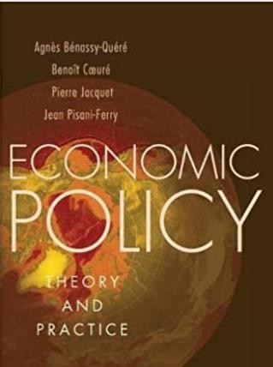
Reading list - *Lectures*
Bénassy-Quéré, A. et al. (2010), Economic Policy: Theory and Practice, Oxford University Press.
Lecture handouts
Book chapter notes covering chapters 1 to 4 of lectures
* Lecture handouts and all other materials will be uploaded onto Fenix.

Slide 5
Recommended online resources:
https://www.economist.com/
https://www.project-syndicate.org/
https://www.politico.com/
https://www.vox.com/

Slide 6
Setting out expectations
I expect you to:
Participate in classes in a constructive way;
Read the course materials;
Give me feedback on what works and what doesn’t work.
You should expect me to:
Explain materials in a clear way;
Help you with course-related difficulties;
Be available to help you provided you have tried yourself first.

Slide 7
Student Assessment
The final grade consists of the weighted average of:
lectures: the grade obtained in four in-class quizzes taken by students during the lectures, each worth 12.5%.
tutorials: the grade obtained in the tutorials, composed of group presentation (20%), group
discussion (20%), and individual participation (10%).
NB: Students need to have a grade of at least 7 marks in both assessments carried out in lectures and tutorials.
The students who fail or wish to improve their grade can take a re-sit exam in the second examination period. The written exam is worth 100% of the final grade and contains a proportional number of questions from the lectures and the tutorials.
The students who do not participate in the evaluation taken in the lectures and tutorials can only take
the re-sit exam in the second examination period.

Slide 8
Reading #1:How Much Has the Pandemic Cost?
https://www.project-syndicate.org/commentary/how-much-has-the-pandemic-cost-by-andrew-sheng-and-xiao-geng-2022-01

Slide 9
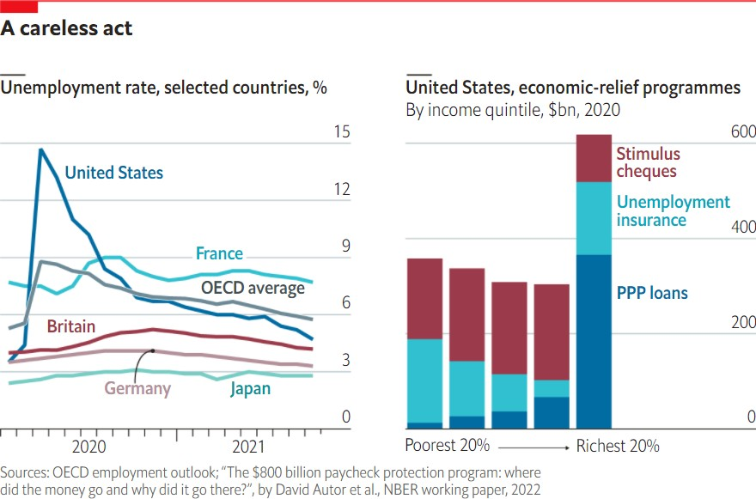
Reading #2:America’s covid job-saving programme gave most of its cash to the rich
https://www.economist.com/graphic-detail/2022/01/31/americas-covid-job-saving-programme-gave-most-of-its-cash-to-the-rich

Slide 10
Any questions?

